Slide 1
Migrating Microsoft workloads to AWS
Cloudboosta Academy

Slide 2
INTRODUCTION

Slide 3
In The Beginning
There was NO CLOUD
There were:
Servers
Racks
Power Units
Air Conditioners and Cooling Units
Routers, Switches, Hubs …plus many cables

Slide 4
In Those Days
It took months to order servers
If there were restrictions , it could turn into years
Projects were delayed and could even be derailed
Server dimensioning was a headache
Money lost by overprovisioning servers or hitches in peak times due to under-provisioning
CTO headache

Slide 5
In March 2006
The Lord of Innovation and Invention
Heard the cry of System Admins and Architects and CTOs
Sent AWS CLOUD to the Rescue

Slide 6
Cloud Advantages
Ability to provision capacity needed with possibility for flexible extension
On-demand scaling reducing idle infrastructure,
Cost based on Consumed Capacity
Easy and Rapid deployment of Infrastructure, OS and Codes
Reduced Cost
Reduction of product time-to-market
Better competitive positioning
Positive effect on cash flow
STRONG MIGRATION BUSINESS CASE

Slide 7
Microsoft Workloads
68.2% share of the Desktop operating system
Second to Linux by market share in server market
Leader in Office Productivity
Strong contender in database and Enterprise ERP
Migration of On-premise to AWS will involve Microsoft

Slide 8
Project Brief
Migration of On-Premise SQL Server Database to AWS RDS SQL Server
Trust relationship established between AWS Microsoft Active Directory (AD) Service and an on-premises Microsoft Active Directory
  Access to resources in either domain
  Single sign-on experience
Route 53 Resolver :resolve DNS queries between the AWS VPC and on-premises AD
  DNS name resolution kept local to the AWS Region
  Lower latency and higher level of security and governance
AWS Database Migration Service (DMS)
  Connect and migrate data from On-Premise SQL Server to AWS RDS Sql Server Instance

Slide 9
ARCHITECTURE

Slide 10
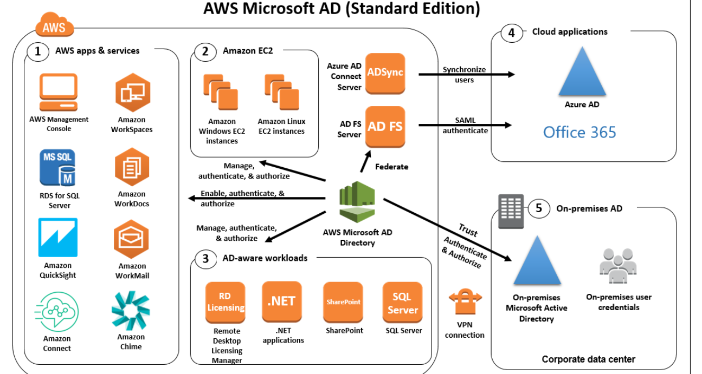

Slide 11
AWS SERVICES USED

Slide 12
AWS Services Used
CloudFormation
AWS Microsoft Active Directory (AD)
IAM
Directory Service
Route 53 Resolver
EC2
AWS Systems Manager
  Session Manager
  Fleet Manager
VPC (Subnet, Security Group)
Database Migration Service (DMS)
RDS

Slide 13

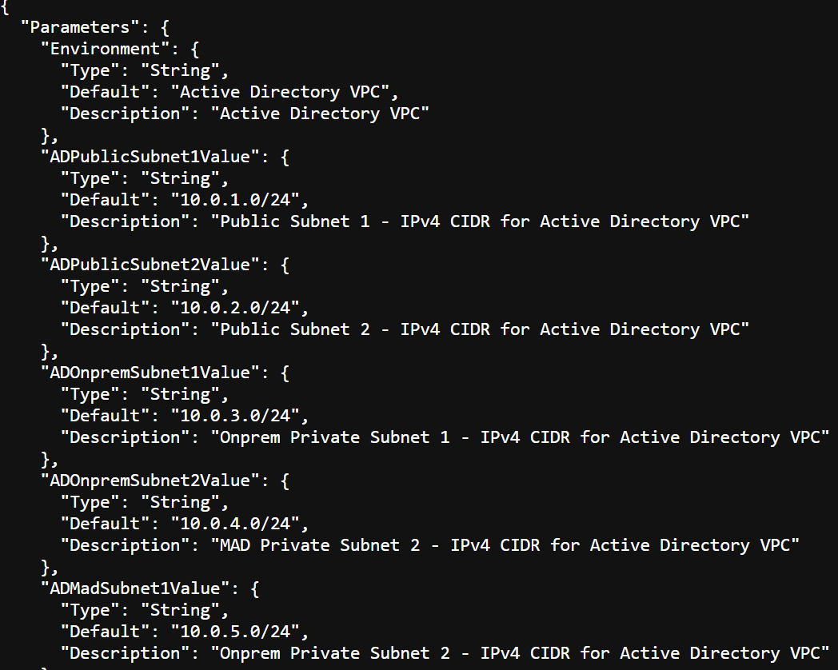
CloudFormation
AWS CloudFormation
Autoprovisioning of the networking layer using a Template (json file)
VPC
2 Public Subnets where the AD Management Server was deployed.
2 Private subnets used for AWS MAD and the RDS Service.
2 OnPrem Private Subnet to deploy EC2 instances to simulate on-premises datacenter.
Internet Gateway attached to the Public Subnet
Nat Gateway to allow traffic between the private subnets and the Public subnet for secure internet access.
Route Tables

Slide 14

AWS Managed Microsoft AD
AWS Managed
Microsoft AD
Fully managed Microsoft AD by AWS in the AWS Cloud
Enables the migration of Active Directory aware applications to the cloud
  Microsoft SharePoint, Microsoft SQL Server Always On Availability Groups, and many .NET applications
Supports AWS managed applications and services e.g.
  AWS Client VPN, AWS Management Console, AWS IAM Identity Centre, Amazon Chime, Amazon Connect
Supports Federation of stored credentials to run Microsoft Cloud applications through Microsoft Entra and AD Federation Service

Slide 15
AWS Managed Microsoft AD
AWS Managed
Microsoft AD
ROLE
Enables the mapping of onsite users' windows credentials to IAM Roles after establishing a Trust relationship with onsite
  Windows User to AWS Role with the policy AmazonEC2ReadOnlyAccess attached
  Windows Admin mapped to AWS Role with the policy AmazonEC2FullAccess attached
Deployed in a private subnet within the configured VP
  Administered by AD Management Server in a public subnet joined to its domain

Slide 16

IAM
AWS Identity and Access Management (IAM)
Creation of users and roles
  IAM super user with full administrative right used for the configuration
  Temporary roles assigned to windows users (EC2 Administrator and EC2 Developer)
  Role used to attach an instance to AWS Microsoft AD (Domain Join Role)
Assign AD Users and Groups to IAM Roles

Slide 17

Directory Service
AWS Directory
Service
Creation of application URL for the AWS Managed AD used by on-premise service to connect to AWS Console
Assigning AD Users and Groups to IAM roles
  Active Directory
    AWS Managed AD
  IAM Roles
    AWSDevelopers
    AWSAdmins

Slide 18

Route 53 Resolver
Amazon Route 53
Resolve DNS queries between the AWS VPC and on-premises AD
Kept the DNS name resolution local to the AWS Region
Lower latency and higher level of security and governance.

Slide 19

EC2
Amazon Elastic Compute Cloud (Amazon EC2)
Deployment of machine instances
On-Premise Active Directory Server (Windows 2022 AMI t2.medium)
  Private subnet (different from AWS Managed Microsoft AD)
On-Premise SQL Server (Windows_Server-2022-English-Full-SQL_2019_Standard, m5.xlarge)
  Private subnet (different from AWS Managed Microsoft AD)
AD Management Server (Windows 2022 AMI ,t2.xlarge)
  Public subnet
  SQL Server Management Studio Installed
  Used to administer the AWS Managed Microsoft AD, the On-premise AD Server
    Creation of Trust Relationship between AWS Managed Microsoft AD and On-Premise AD Server via Server Manager
  RDP Access into the On-premise AD Server and SQL Server (jump box)
    Installation of Active Directory on the on-premise AD Server
    Installation of SQL Server on the on-premise SQL Server

Slide 20

AWS Systems Manager
AWS Systems Manager
Session Manager (single instance) and Fleet Manager (multi-instance)
Connection to EC2 Instances
  No need for rdp or ssh access configuration
  Direct connection (similar to instance connect or cloudshell)
Speeds up configuration and deployment speed

Slide 21

VPC
Amazon Virtual Private Cloud (Amazon VPC)
Network Management
2 Public Subnets where the AD Management Server was deployed. Internet Gateway will be attached to those subnets only.
2 Private subnets used for AWS MAD and the RDS Service.
2 OnPrem Subnet used to deploy EC2 instances to simulate on-premises datacenter. Nat Gateway was attached to those subnets for secure internet access.

Slide 22

Database Migration Service
AWS Database Migration Service (AWS DMS)
Tool used to migrate data from the Source (EC2 On premise SQL Server) to the Target (AWS RDS SQL instance)

Slide 23

AWS RDS
Amazon Relational Database Service (Amazon RDS)
Fully managed AWS Relational Database Service
Target Database to be migrated to
Same private subnet as the AWS Managed AD

Slide 24
IMPLEMENTATION

Slide 25
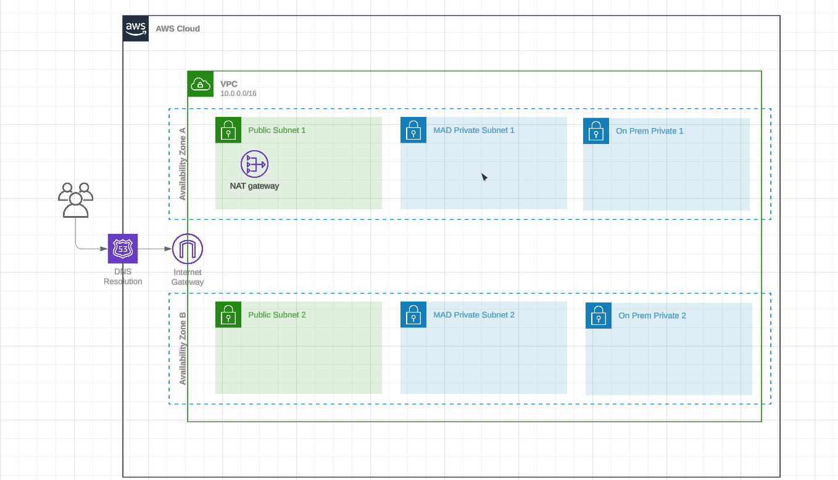

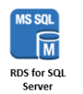


Implementation
AD Management Server
On Prem AD
On Prem AD

Slide 26
Create the VPC Network Layer
Deploy AWS Managed Microsoft AD
Install the AD Management Server
Install and Configure Active Directory on EC2
Setting Up Trust between AWS Managed AD and OnPrem AD
Federating Active Directory for AWS Console
Integrating AD with Route 53 Resolvers
Launching & Connecting RDS for SQL Server
Launching SQL Server on EC2 Windows
Use DMS to migrate SQL Server to RDS SQL

Slide 27
1. CloudFormation to Provision Network Layer
AWS Console
Cloud Formation
Stack Creation with Json Template
AWS CloudFormation

Slide 28
2. Deploying AWS Managed Microsoft AD
AWS Console
Directory Service
Deploy in Private Subnet
AWS Managed
Microsoft AD

Slide 29
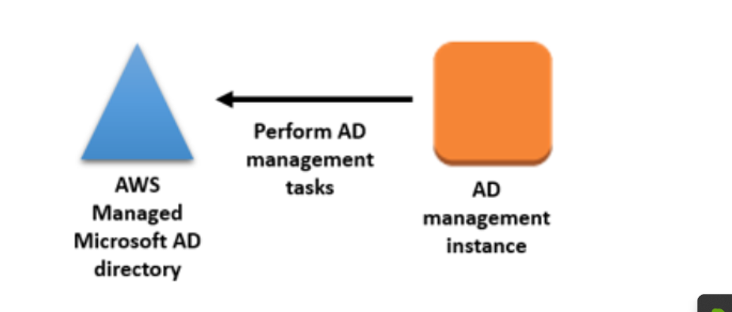
3. Deploy AD Management Server
AWS Console
EC2 Instance
Deploy in Private Subnet
Install Active Directory Service Tools

Slide 30
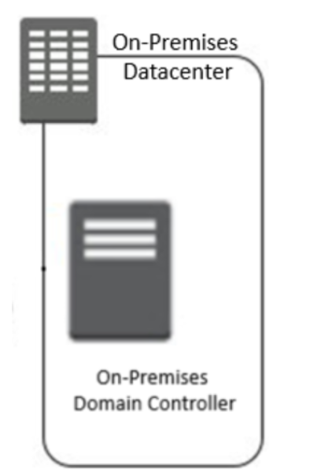
4. Install On-Prem AD
AWS Console
EC2 Instance
Deploy in Private Subnet
Install Active Directory

Slide 31
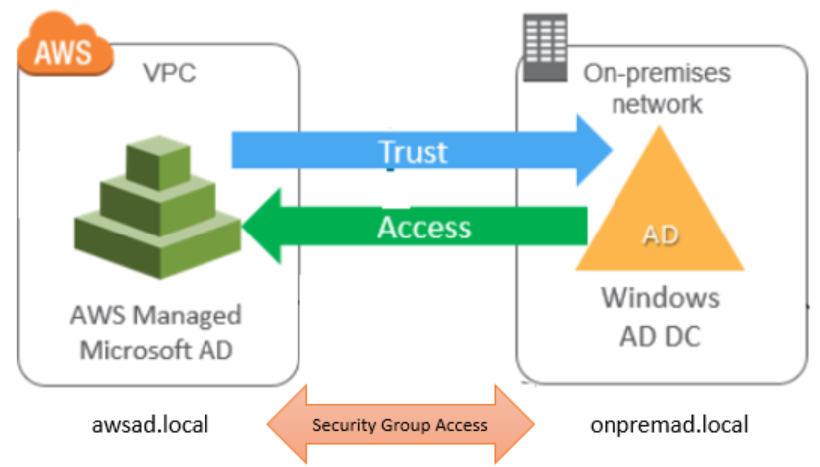
5. Setting Up Trust With AWS Managed AD
RDP to ON Prem AD via AD Management Server
Open Server Manager/Tools/DNS
  DNS Server
  Configure Conditional Forwarder (FQDN of the AWS Managed Microsoft AD)
Domain and Trust
  Trust/AWS Managed AD
AWS Management Console
Directory Service/Trust Relationships
Add on Prem AD Domain

Slide 32
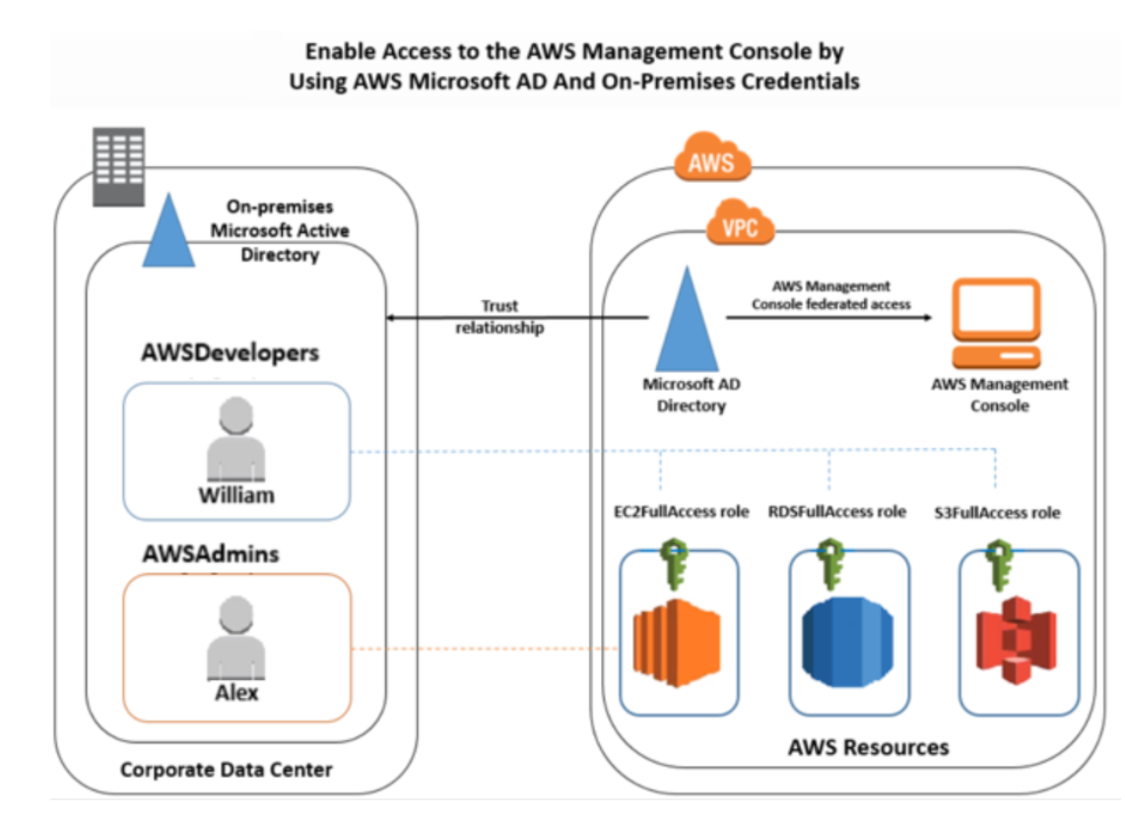
6. Active Directory for AWS Console

Slide 33
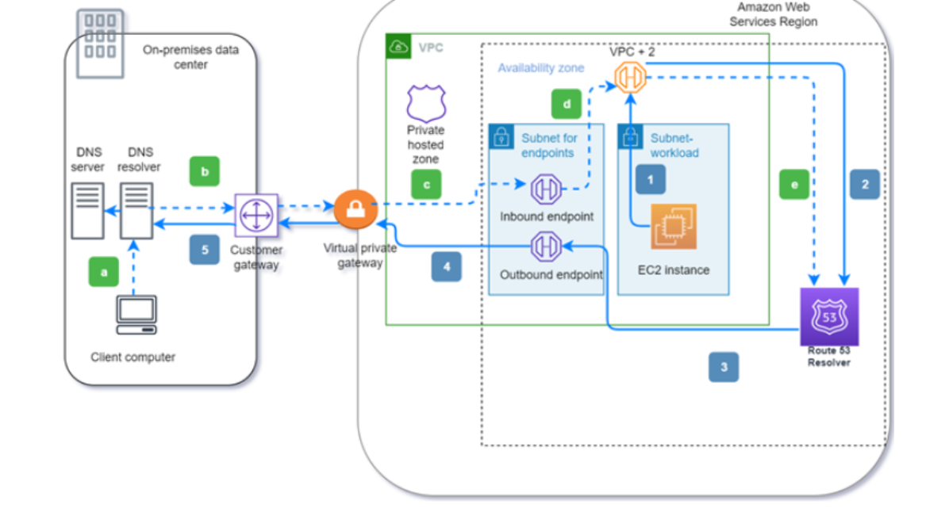
7. Integrating AD with Route 53 Resolvers
AWS Console
Resolver Console
Configure Inbound and Outbound Endpoint

Slide 34
8. Launching & Connecting RDS for SQL Server
AWS Console
RDS Console
Database Creation
Creation of Customer DB table into which data will be migrated

Slide 35
8. Install SQL Server on EC2 Windows
AWS Console
EC2 Instance (Windows SQL Server)
Database Creation
Creation of Customer DB table and population with 10,000 records to be migrated

Slide 36
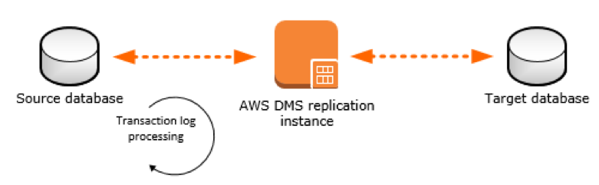
9. Use DMS to migrate SQL Server to RDS SQL
AWS Console
DMS Dashboard
Create Replication Instance
Create Source Endpoint
Create Target Endpoint
Start Migration Task

Slide 37
CHALLENGES

Slide 38
CHALLENGES
Unavailability of On-Premise Servers
  Workaround to deploy on separate Private Subnet
Windows Powershell Error on the On-Premise EC2 SQL Instance
  Powershell v5 on Windows Server 2015 does not support Get-Credential
  Solution found on Github
Incomplete Commands in the Configuration of Windows Active Directory on the EC2 Instance
Security Group Configurations

Slide 39
SOLUTION EVALUATION
AWS Well Architected Framework
AD Management server
  Critical piece of equipment (could be a single point of failure)
  Only point of Access from on-premise
  Security Group configured to allow ONLY one fixed IP in the source
Reliability
  Multiple Availability Zones to ensure a highly available, fault tolerant, and scalable.
  AWS Active Directory Service deployed as a pair of DC Controllers in a different Availability Zone
Security
  Security Groups

